Slide 1
Towards Graphical Configuration in the INTO-CPS Application

Slide 2
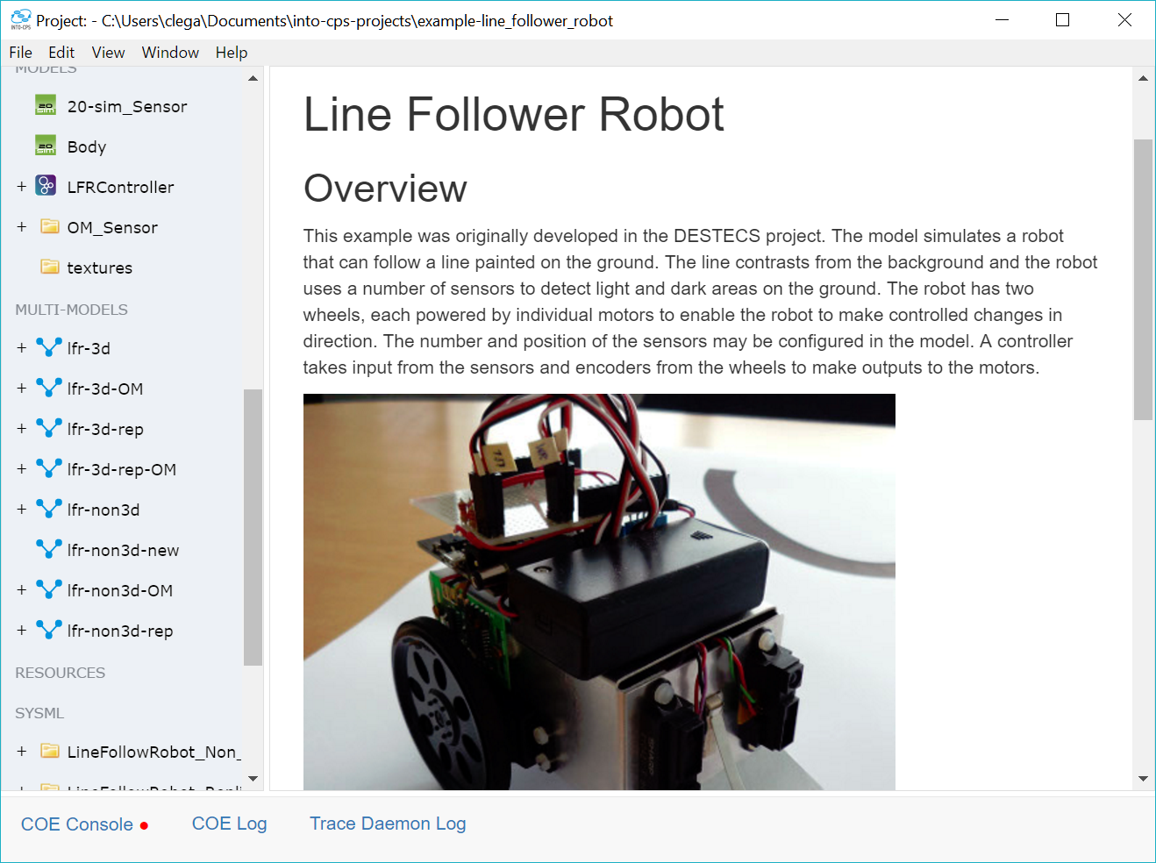
Background
System Engineering course
Powerful Tools
Frustrating user interface

Slide 3
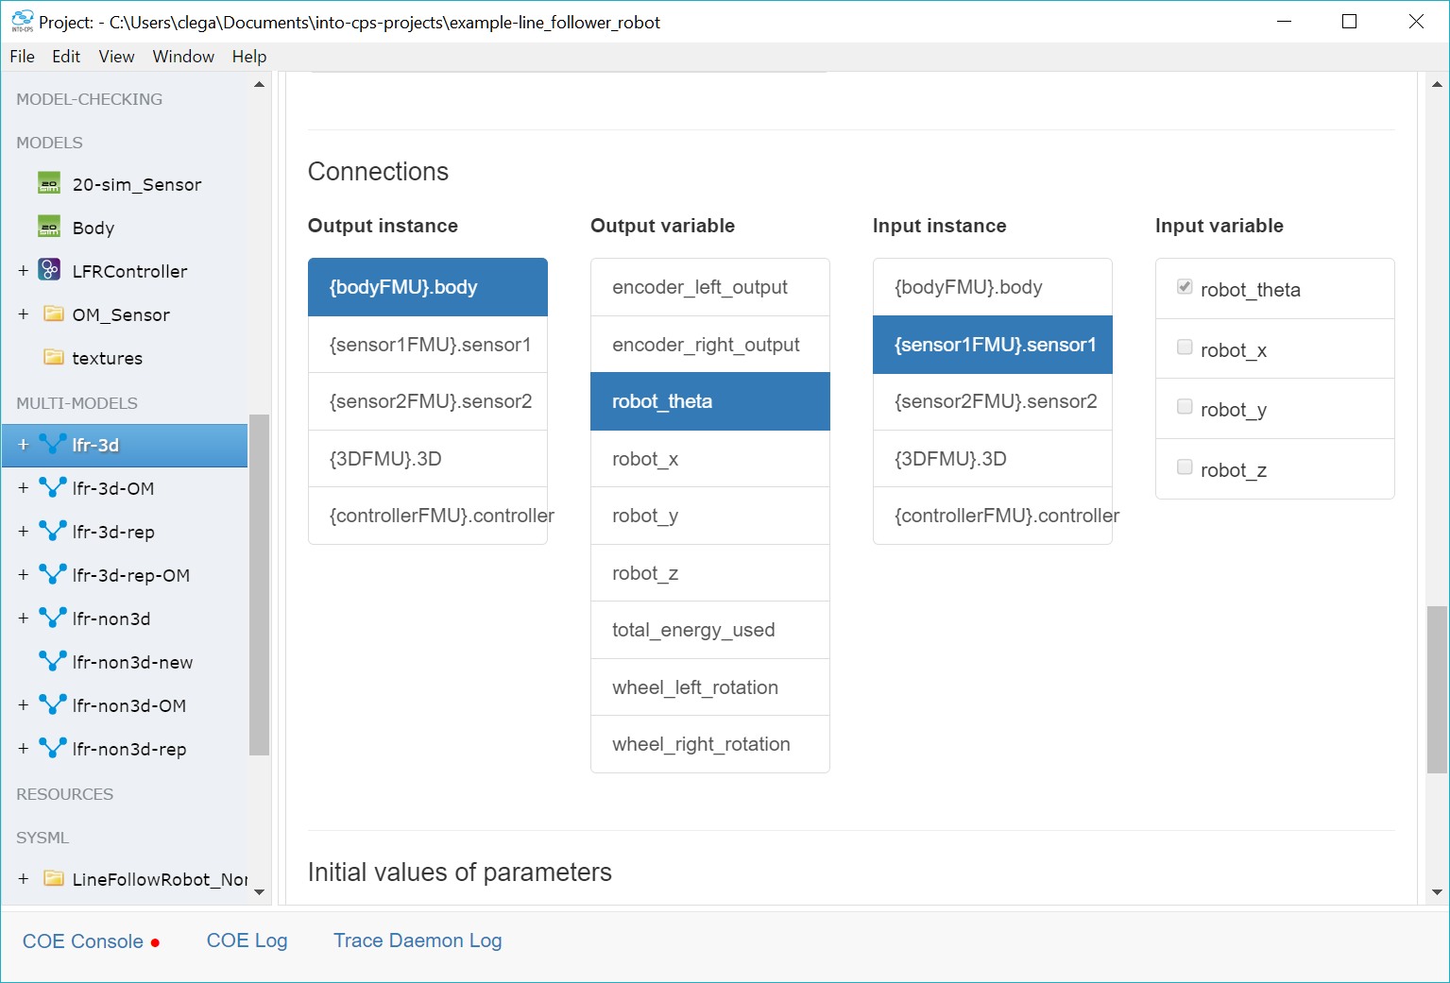
Connections inside application
Poor overview
Find un-connected port?
Notes:
Questions for audience:
Q1: which FMU is total_energy_used connected to?
A1 : the controller, but why?

Slide 4
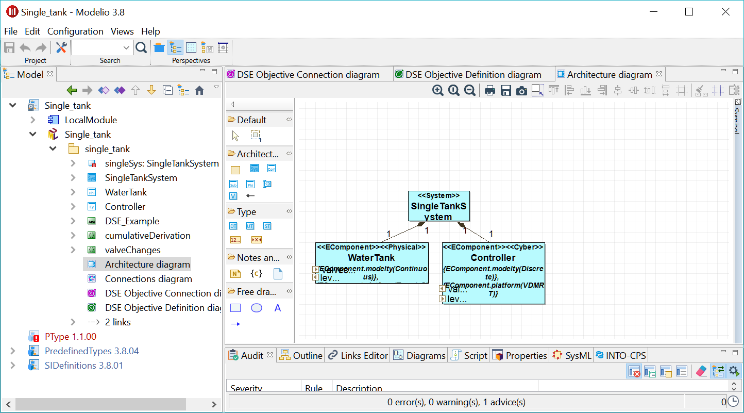
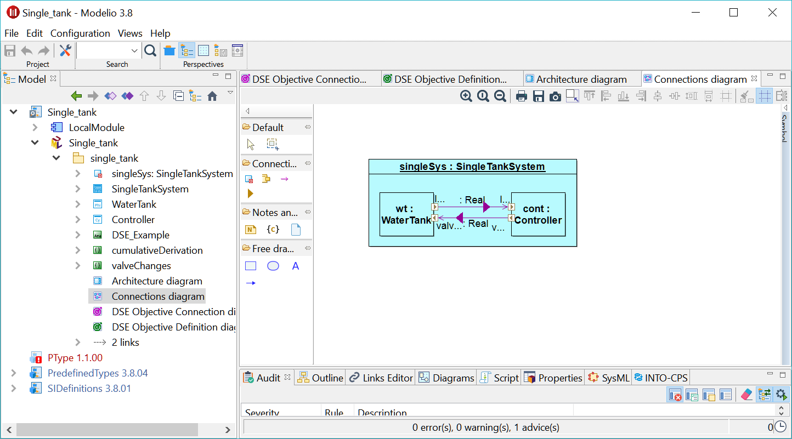
SysML profile
Better overview
Familiarity
Complexity
Exchangeability?
Notes:
Complexity:
Several different diagrams needed to capture model
Requires intimate knowledge of how to express concepts using profile

Slide 5
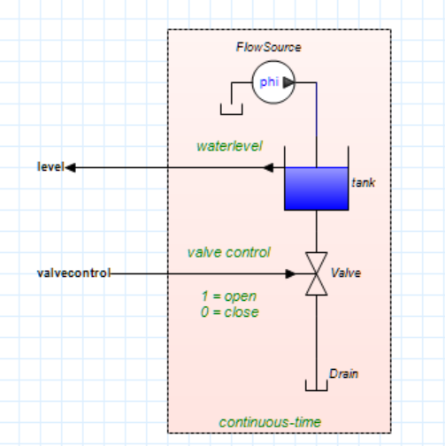
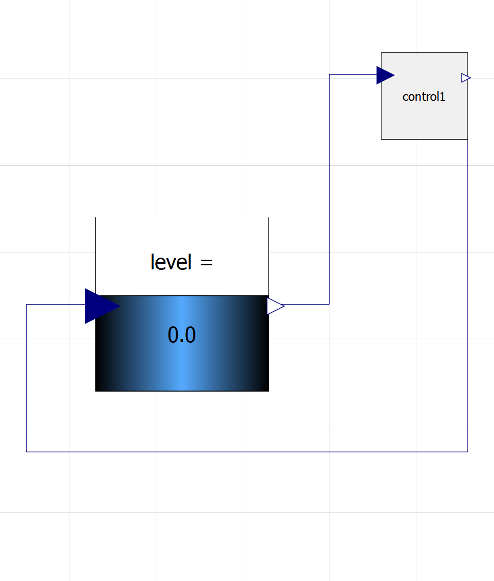
Graphical editors – other tools
Tools: 20Sim, OMEdit and Matlab
Integrated block-based design
Different from SysML-profile ?
Notes:
Consistent experience
Tools for generating FMUs are already using this approach.
Conceptually similar to SysML
Different from SysML profile:
Yes! More efficient as it can leverage domain specific knowledge to assist the user

Slide 6
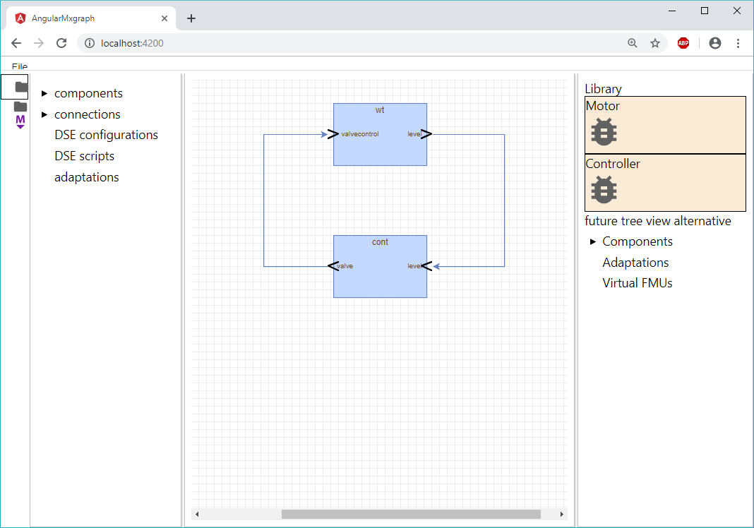
Graphical Editor – INTO-CPS Application
Goal: integrate in desktop and cloud application
Block-based design on system level
Faster development loop

Slide 7
Graphical Editor – Project view
Project View
Canvas View
Library View

Slide 8
Storage Representation – MultiModel
Simple JSON format
Requires drilling into FMU archive
Can not describe geometry of system

Slide 9
Storage Representation –
System Structure and Parameterization

Slide 10
Future Work – Hierarchical

Slide 11
Future Work – Semantic Adaptation

Slide 12
Future Work – Storage Format

